Slide 1
Reinforcement Learning Based Approach for Task Performance in Simulated Environment
Guided By: Presented By:
Ms. Bismin V. Sherif, Tiju George Varghese,
Assistant Professor M.Tech AI & DS,
MUT21CSAD04

Slide 2
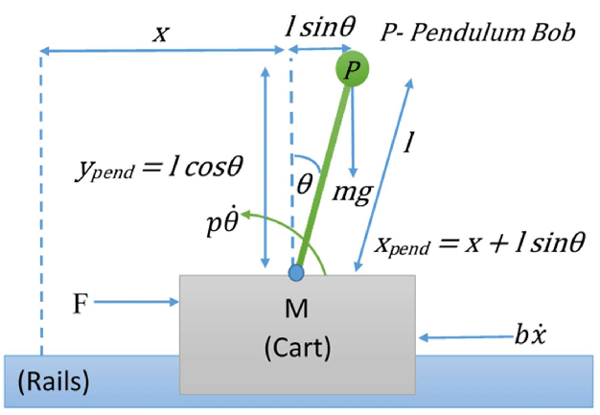
Problem Statement
The inverted pendulum is a classic problem in dynamics and control theory and is used as a benchmark for testing control strategies.
The center of mass of a cartpole system (inverted pendulum) is above its pivot point.
It is an unstable system and can be stabilized by using a control system to monitor the angle of the pole and move the pivot point horizontally back under the center of mass when it starts to fall over, keeping it balanced.
A normal pendulum is stable when hanging downwards, an inverted pendulum is inherently unstable, and must be actively balanced in order to remain upright.
Cartpole System (Inverted Pendulum)

Slide 3
Objectives
To develop an intelligent agent for cartpole balancing task in a simulated environment using reinforcement learning(actor critic).
To compare the performance of the agent with other GA based agent.

Slide 4
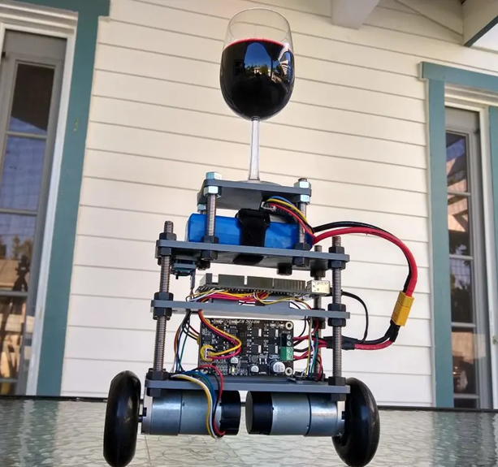
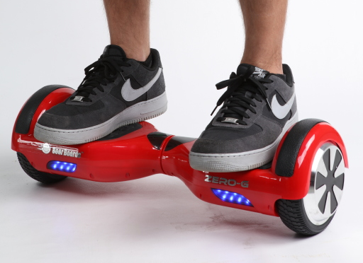
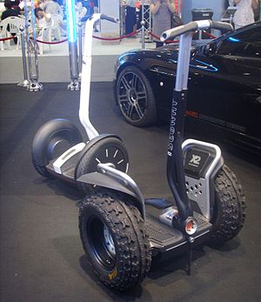
Motivation
It finds application self balancing transportation systems.
It also finds application in robotics.
It finds use as a benchmarking problem in control theory.
Drink serving robot
A self-balancing hoverboard
Two-wheeled, self-balancing personal transporter

Slide 5
Abstract
Reinforcement learning (RL) is an area of AI concerned with how intelligent agents decides to take actions in an environment in order to maximize the cumulative reward. Here the focus is on finding a balance between exploration and exploitation.
A control problem includes a cost function that is a function of state and control variables. Classical physics control problems are balancing (cartpole problem), floating in air and safe landing (drones), object-fetching (robots), line following (robot), hill-climb (self-driving car). Optimal control deals with the problem of finding a control law for a given system such that a certain optimality criterion is achieved.
CartPole, also known as inverted pendulum, is a task in which we try to balance the pole as long as possible. The goal of this task is to move the cart left and right so that the pole can stand (within a certain angle) as long as possible.
The aim of this mini-project is to design and develop an intelligent agent for CartPole balancing task using reinforcement learning techniques along with associated libraries and toolkits.

Slide 6
Area
Reinforcement Learning
Control Theory

Slide 7
Literature Survey

Slide 8
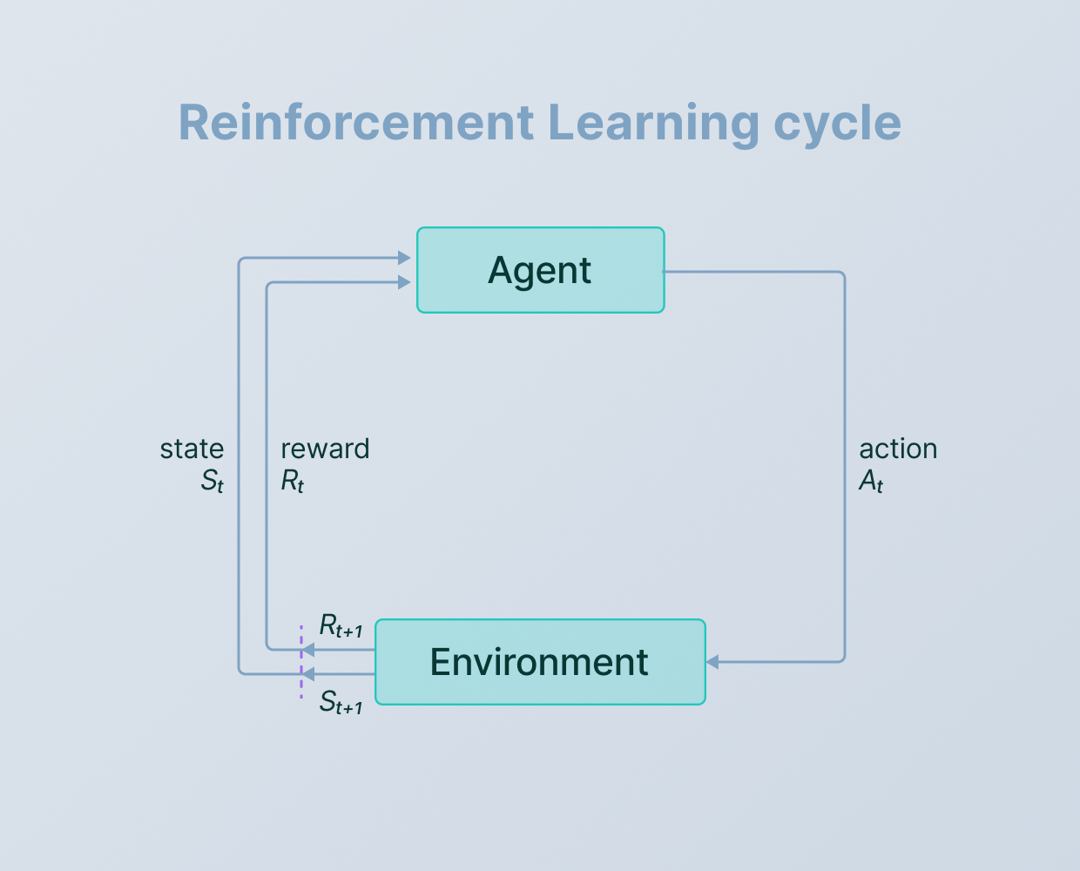
Reinforcement Learning, Fast and Slow Botvinick Mathew, Ritter Sam, Wang Jane, Kurth-Nelson Zeb, Blundell Charles, Hassabis Demis, “Reinforcement Learning, Fast and Slow”, Trends in Cognitive Sciences, Vol 23, pp.408-422, 2019.[1]

Slide 9
Agent: An entity that can perceive/explore the environment and act upon it.
Environment: A situation in which an agent is present or surrounded by. In RL, we assume the stochastic environment, which means it is random in nature.
Action: Actions are the moves taken by an agent within the environment.
State: State is a situation returned by the environment after each action taken by the agent.
Reward: A feedback returned to the agent from the environment to evaluate the action of the agent.
Policy: Policy is a strategy applied by the agent for the next action based on the current state.
Value: It is expected long-term retuned with the discount factor and opposite to the short-term reward.
Q-value: It is mostly similar to the value, but it takes one additional parameter as a current action (a).

Slide 10
There are mainly three ways to implement reinforcement-learning in ML, which are:
Value-based method: In value-based approach we find the optimal value function, which is the maximum value at a state under any policy. Therefore, the agent expects the long-term return at any state(s) under policy π. (eg: Q learning, Deep Q network)
Policy-based: Policy-based approach is to find the optimal policy for the maximum future rewards without using the value function. In this approach, the agent tries to apply such a policy that the action performed in each step helps to maximize the future reward. eg: Proximal Policy Optimization, Trust region policy optimization.
Model-based: In the model-based approach, a virtual model is created for the environment, and the agent explores that environment to learn it. There is no particular solution or algorithm for this approach because the model representation is different for each environment.(eg: World Models,Model based value estimation).

Slide 11
Fluid Directed Rigid Body Control using Deep Reinforcement Learning Pingchuan Ma, Yunsheng Tian, Zherong Pan, Bo Ren, Dinesh Manocha, “Fluid directed rigid body control using deep reinforcement learning”, ACM Transactions on Graphics, Vol 37,Issue 4, pp.1-11, August 2018.[2]
This paper presents an agent that operates in a 2D environment in which rigid bodies are controlled using fluid jet.
The fluid’s velocity field is extracted using a convolutional autoencoder. The encoded features and other rigid features are combined and then feed into the multilayer perceptron (MLP) to get the action.
The MLP and the encoder are trained using a deep reinforcement learning (Trust region policy optimization) algorithm.

Slide 12
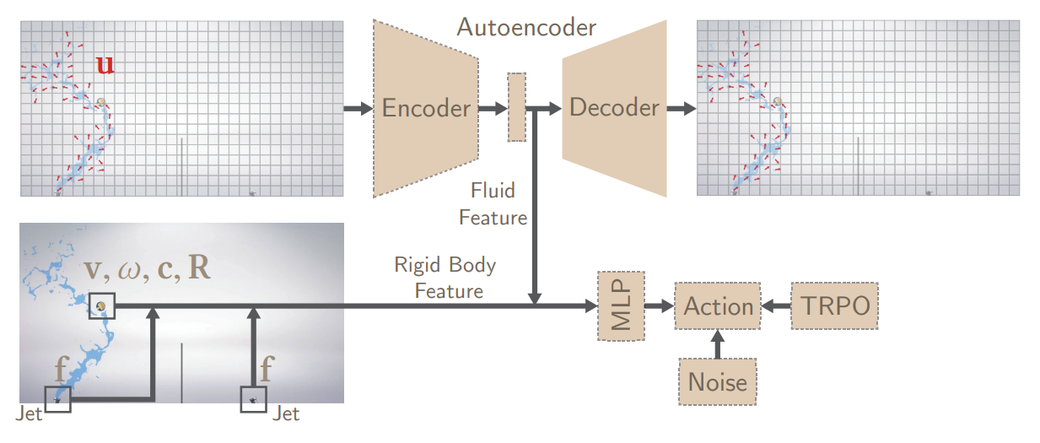
Rigid Body Control System

Slide 13
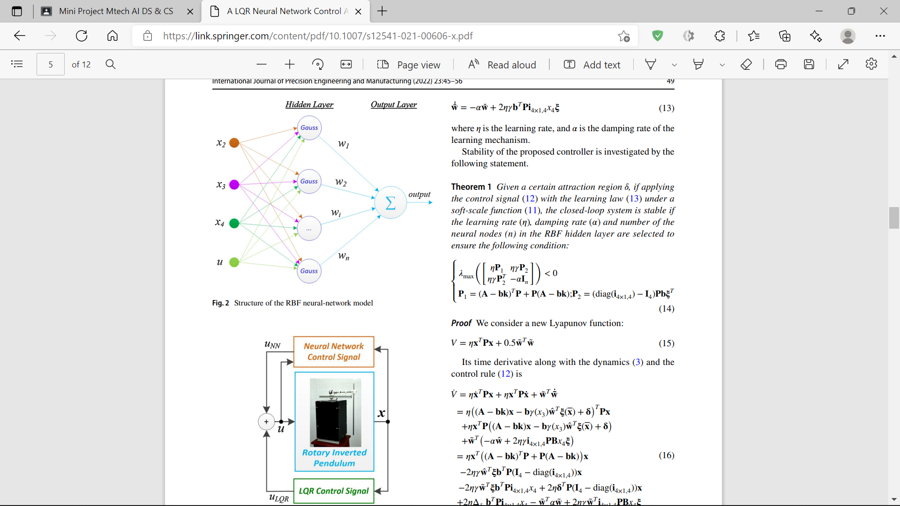
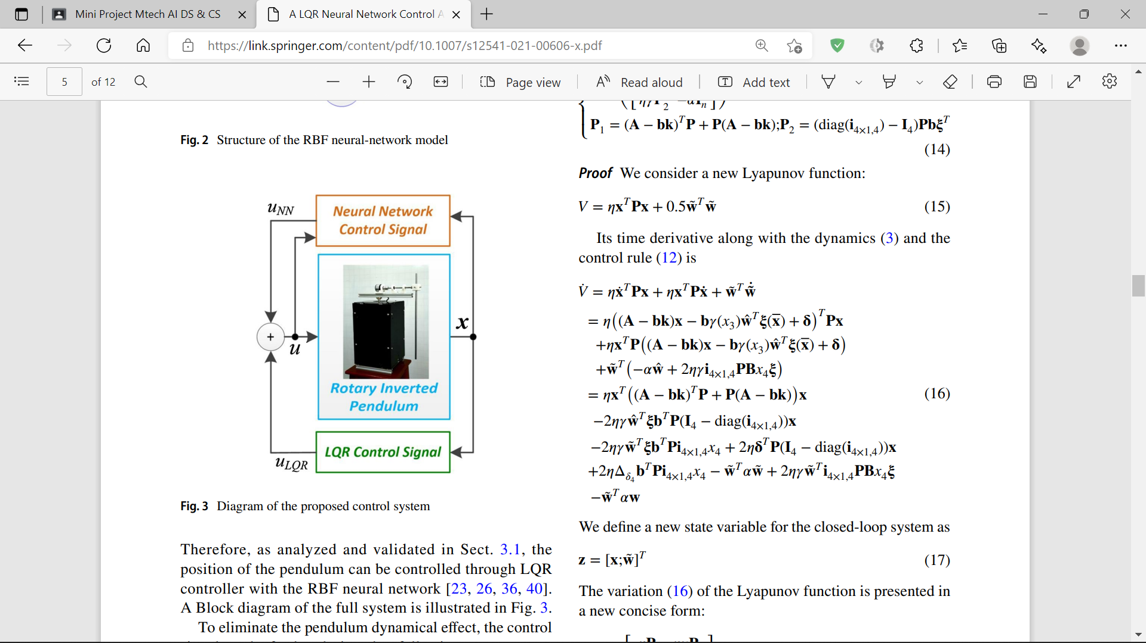
A LQR Neural Network Control Approach for Fast Stabilizing Rotary Inverted Pendulums H. V. Nghi et , Huynh Vinh Nghi, Dinh Phuoc Nhien, Dang Xuan Ba, "A LQR-based Neural-network Controller for Fast Stabilizing Rotary Inverted Pendulum," International Conference on System Science and Engineering (ICSSE), pp.19-22, 2021.[3]
The intelligent control signal is generated by a two-layer neural network that could support the fast stabilization process and, on the other hand, quickly release the control resource to the linear quadratic regulator (LQR) once the system approaches the expected position.
Effectiveness and feasibility of the proposed control technique were carefully investigated by comparative simulation and real-time experiments.
RBF Network
Control System

Slide 14
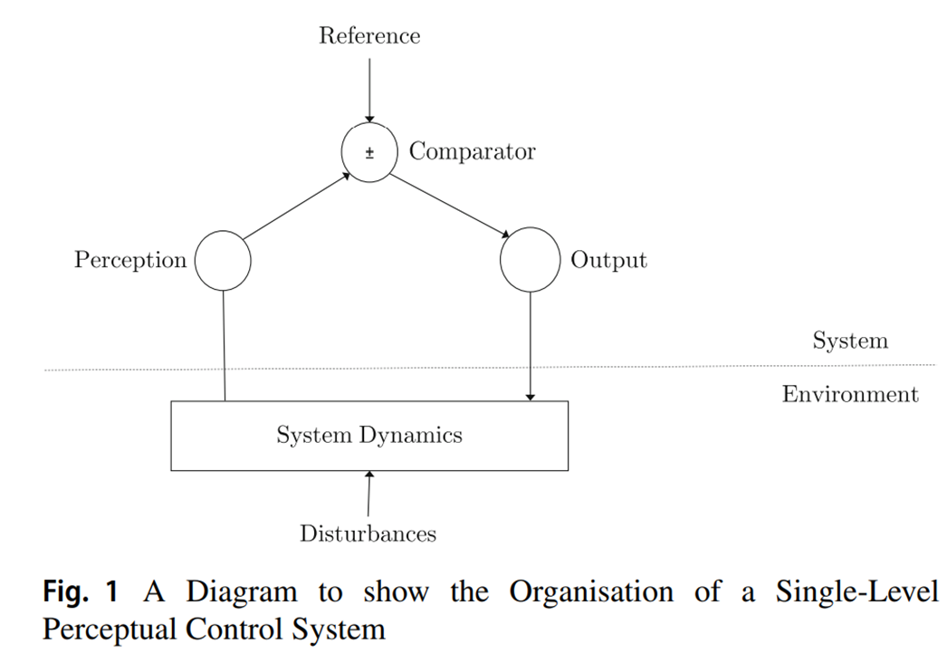
Implementation of a Perceptual Controller for an Inverted Pendulum Robot Johnson, T., Zhou, S., Cheah, W. et al., “Implementation of a Perceptual Controller for an Inverted Pendulum Robot”, Journal of Intelligent & Robotic Systems ,Vol.99, pp.683–692, 2020.[4]
This paper presents the first direct comparison of a Perception Control Theory(PCT) controller for a mobile robot with a classical control method LQR.
PCT was developed by a medical physicist, William Powers, in the 1950s, it provides a functional architecture of behavior based on the principle that ‘behavior is the control of perception’.
Control in living systems can be thought of as a process of continually adapting behavior so that perceptions remain consistent with the internal system purpose.
LQR achieves a compromise between error penalization and control effort by minimising the quadratic cost function.
PCT Controller

Slide 15
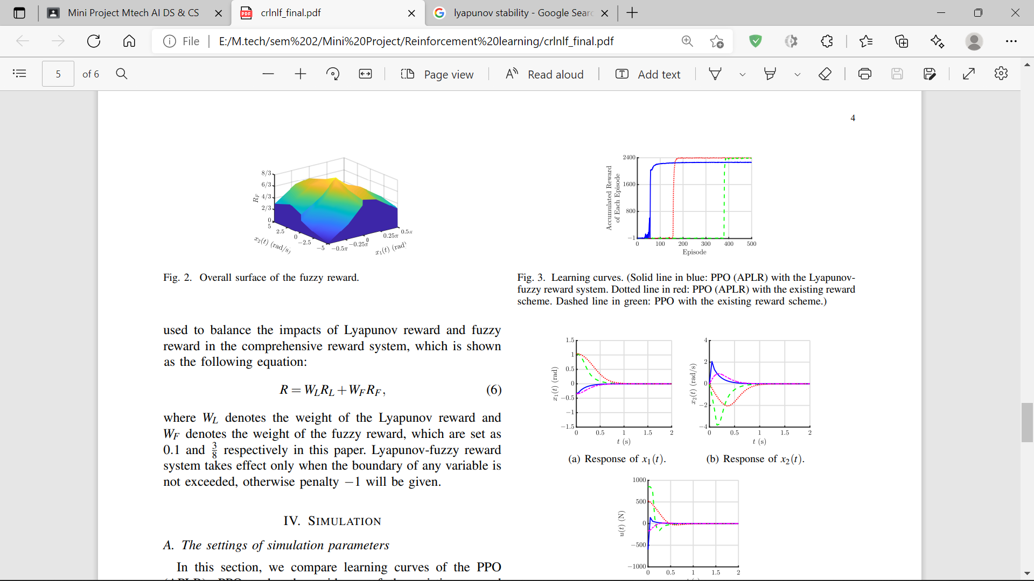
Reinforcement Learning-based Control of Nonlinear Systems using Lyapunov Stability Concept and Fuzzy Reward Scheme M. Chen, H. K. Lam, Q. Shi and B. Xiao, "Reinforcement Learning-Based Control of Nonlinear Systems Using Lyapunov Stability Concept and Fuzzy Reward Scheme”, IEEE Transactions on Circuits and Systems II: Express Briefs, Vol. 67, no. 10, pp. 2059-2063, Oct. 2020.[5]
This paper proposes a Lyapunov-fuzzy reward system to further promote the learning efficiency for nonlinear systems.
The proposed control approach absorbs the Lyapunov stability concept into the design of the Lyapunov reward system and a particular fuzzy reward system is set up using the knowledge of the cart-pole inverted pendulum and fuzzy inference system (FIS). The merits of the proposed approach are validated by simulation examples.
Key idea is to choose a Lyapunov candidate function that should be positive definite. The control action should be selected so as to make the first derivative of the Lyapunov function negative definite.

Slide 16
Genetic Algorithm‑Optimized Fuzzy Lyapunov Reinforcement Learning for Nonlinear Systems Amit Kukker, Rajneesh Sharma, “Genetic Algorithm-Optimized Fuzzy Lyapunov Reinforcement Learning for Nonlinear Systems”, Arabian Journal for Science and Engineering, Springer, Issue.3, 2020.[6]
This paper aims to introduce nonlinear optimization in the fuzzy reinforcement learning (RL) approach through genetic algorithm (GA)-based minimization. In conventional fuzzy RL, an agent attempts to find most optimal action at each stage by choosing an action having the lowest Q value or the greedy action.
Genetic algorithm is used for finding optimal action value in each iteration of the algorithm rather than plain algebraic minimum. For guaranteed stability of the designed controller, we use Lyapunov theory-based fuzzy RL control with GA optimizer.
Comparative evaluation of controller shows that proposed GA-optimized fuzzy Lyapunov RL controller is able to achieve a high success rate with stable and superior tracking performance.

Slide 17
OpenAI Gym Greg Brockman, Vicki Cheung, Ludwig Pettersson, Jonas Brockman G., Cheung V., Pettersson L., Schneider J., Schulman J., Tang J., & Zaremba, W, “Openai gym”, ArXiv Preprint, ArXiv:1606.01540, 2016.[7]
OpenAI Gym is a toolkit for reinforcement learning research. It includes a growing collection of benchmark problems that expose a common interface, and a website where people can share their results and compare the performance of algorithms. This paper discusses the components of OpenAI Gym and the design decisions that went into the software. The following environments are included:
Classic control and toy text: small-scale tasks from the RL literature.
Algorithmic: perform computations such as adding multi-digit numbers and reversing sequences. Most of these tasks require memory, and their difficulty can be chosen by varying the sequence length.
Atari: classic Atari games, with screen images or RAM as input, using the Arcade Learning Environment.
Board games: currently, we have included the game of Go.
2D and 3D robots: control a robot in simulation. These tasks use the MuJoCo physics engine, which was designed for fast and accurate robot simulation.

Slide 18
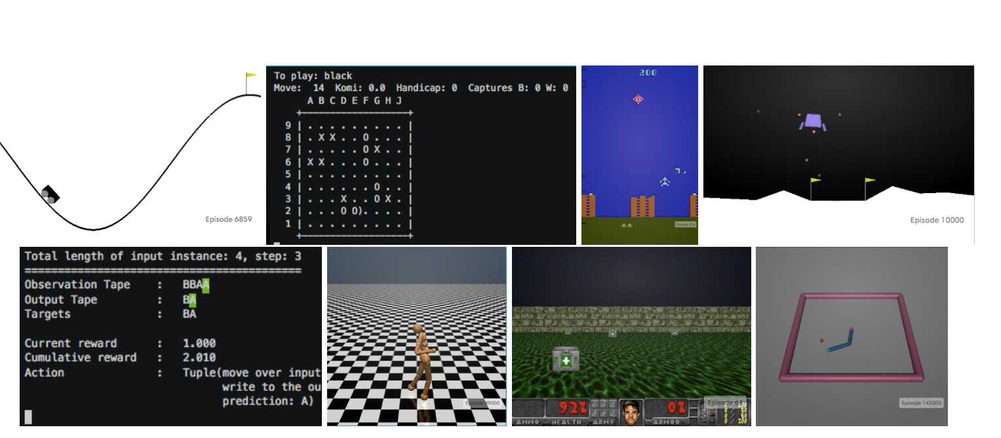
Some Environments in OpenAI Gym

Slide 19
Anomalous RL Environments Mohamad H Danesh, Alan Fern, Out-of-Distribution Dynamics Detection: RL-Relevant Benchmarks and Results.
It is based on OpenAI gym environment.
Is is used for detecting when the dynamics of a testing environment changes compared to the training-distribution dynamics.
This is relevant to applications in control, where changes to test time dynamics can impact the performance of learning controllers/predictors in unknown ways.
This problem is particularly important in the context of deep RL, where learned controllers often overfit to the training environment.
There is a lack of established OODD benchmarks for the types of environments commonly used in RL research.
The first contribution is to design a set of OODD benchmarks derived from common RL environments with varying types and intensities of OODD.

Slide 20
Types of anomalies
Wind Simulation (L2R and R2L): Simulated winds starts to blow after injection from either left-to-right or right-to-left, which impacts the environment dynamics. Wind is simulated in the discrete action environments by changing a percentage of the left/right action to no-op and reinforcing either the right/left action depending on the direction of the wind.
IID Noise: One or more observation sensors is corrupted by IID Gaussian noise. For each environment, the mean and standard deviation are selected as to avoid near-term failure.
Sensor Shutdown: One or more sensors are clamped to zero immediately after the anomaly.
Sensor Calibration Failure: One or more sensors are multiplied by a constant throughout the anomalous run.
Sensor Drift: Relative to the time step in a trajectory, a small amount of noise is injected into the chosen sensor(s). As the trajectory progresses, the magnitude of the injected noise increases.

Slide 21
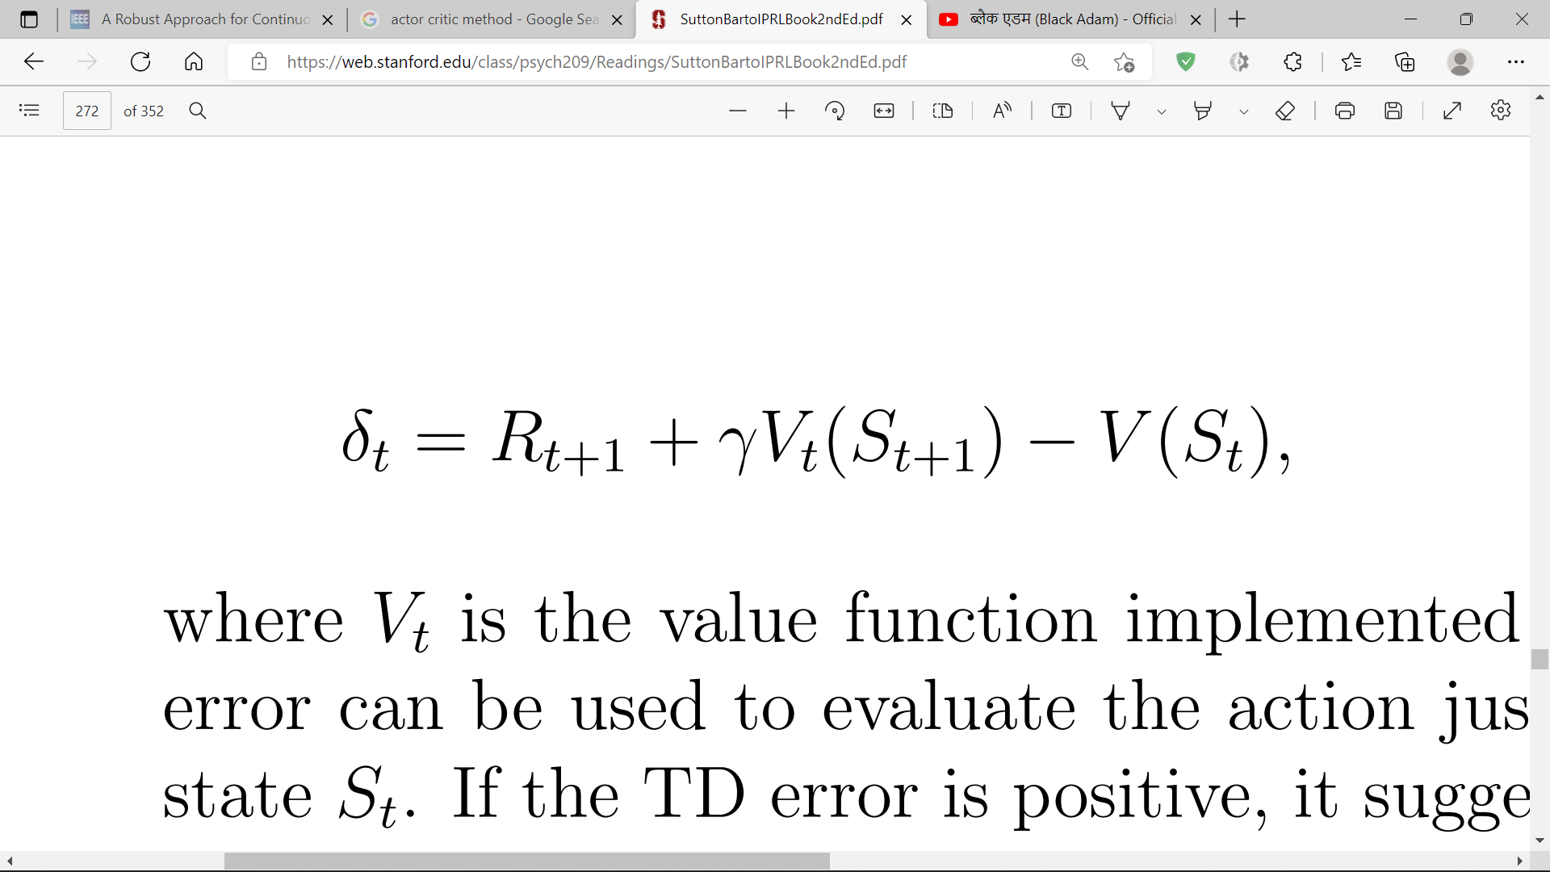
Actor Critic Methods Richard S. Sutton, Andrew G. Barto, Chapter 11: Policy Approximation, Reinforcement Learning: An Introduction, Second edition, 2014
The policy structure is known as the actor, because it is used to select actions, and the estimated value function is known as the critic, because it criticizes the actions made by the actor.
Learning is always on-policy: the critic must learn about and critique whatever policy is currently being followed by the actor. The critique takes the form of a TD error.
Typically, the critic is a state-value function. After each action selection, the critic evaluates the new state to determine whether things have gone better or worse than expected. That evaluation is the TD error

Slide 22
where V_{t} is the value function implemented by the critic at time t.
This TD error can be used to evaluate the action just selected, the action A_{t} taken in state S_{t} .
If the TD error is positive, it suggests that the tendency to select A_{t} should be strengthened for the future, whereas if the TD error is negative, it suggests the tendency should be weakened.

Slide 23
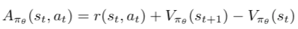
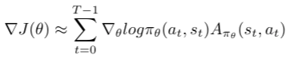
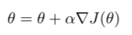
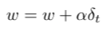
Pseudocode of Actor-Critic algorithm
Sample {s_{t}, a_{t}}using the policy πθ from the actor-network.
Evaluate the advantage function A_{t}. It can be called as TD error δ_{t}. In Actor-critic algorithm, advantage function is produced by the critic-network.
Evaluate the gradient using the below expression:
Update the policy parameters, θ
Update the weights of the critic based value-based RL(Q-learning). δ_{t} is equivalent to advantage function.
Repeat 1 to 5 until we find the optimal policy πθ.

Slide 24
Proposed Agent
To train the agent, follow steps are taken:
Run the agent on the environment to collect training data per episode.
Compute expected return at each time step.
Compute the loss for the combined actor-critic model.
Compute gradients and update network parameters.
Repeat 1-4 until either success criterion or max episodes has been reached.

Slide 25
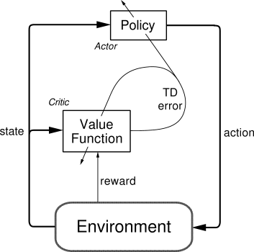

Slide 26
1. Collecting training data
Training data is collected for each episode(state, reward and done flag given an action) .
At each time step, the model's forward pass will be run on the environment's state in order to generate action probabilities and the critic value based on the current policy.
The next action will be sampled from the action probabilities generated by the model, which would then be applied to the environment, causing the next state and reward to be generated.

Slide 27
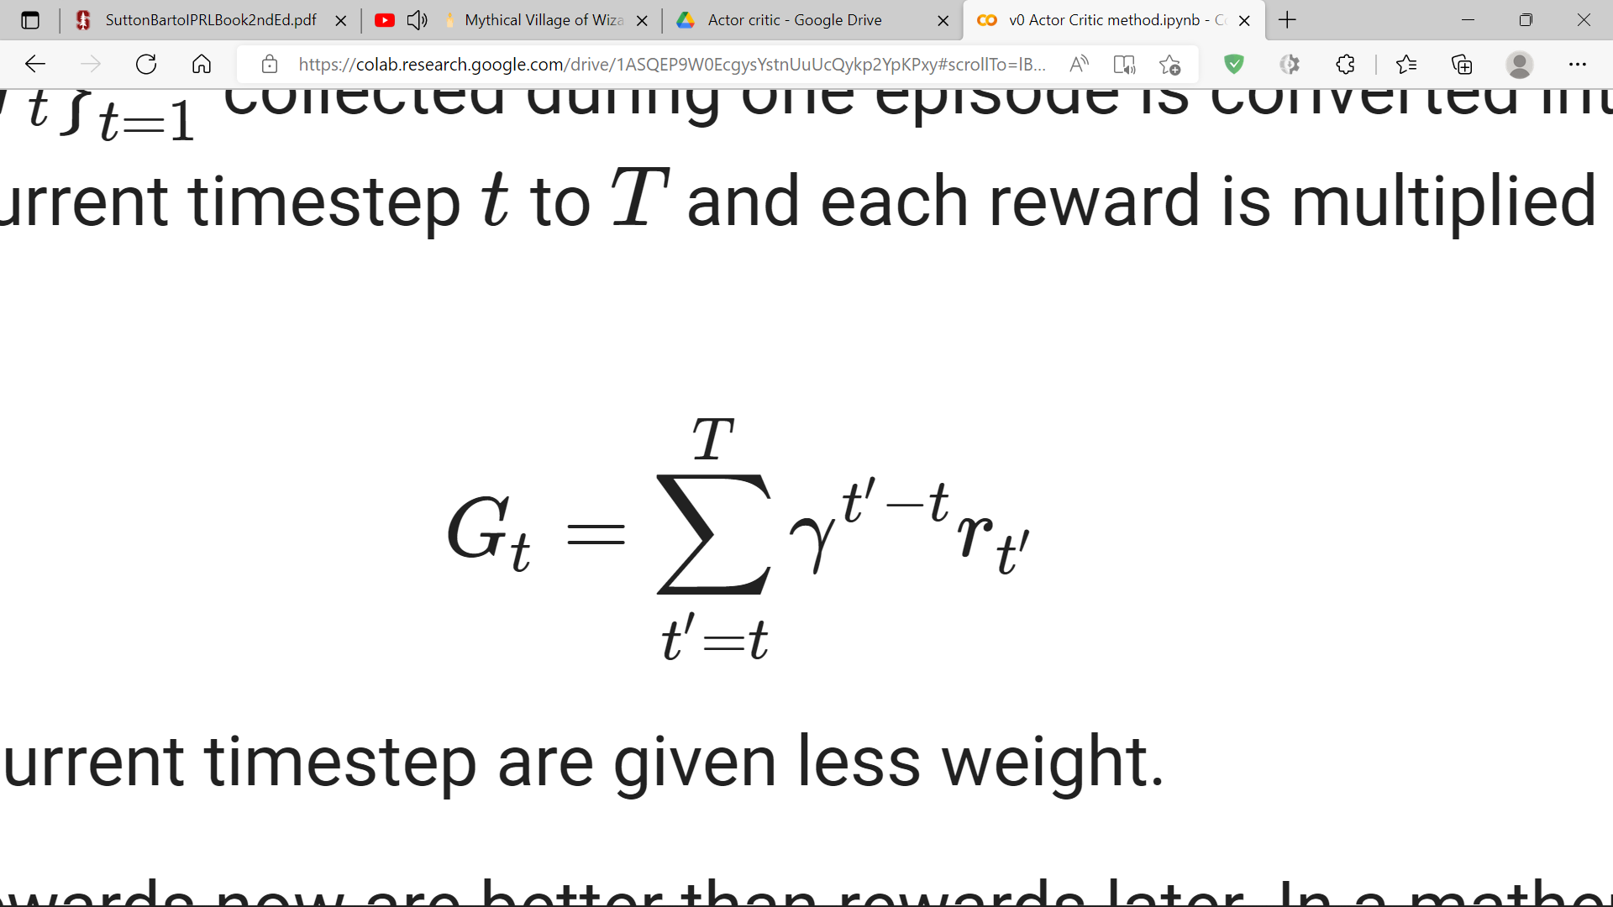
2. Computing expected returns
The sequence of rewards for each timestep t , {r_{t}}^{T}_{t=1} collected during one episode is converted into a sequence of expected returns {G_{t}} ^{T}_{t=1} in which the sum of rewards is taken from the current timestep t to T and each reward is multiplied with an exponentially decaying discount factor γ :
Intuitively, expected return simply implies that rewards now are better than rewards later. In a mathematical sense, it is to ensure that the sum of the rewards converges.
To stabilize training, the resulting sequence of returns is also standardized (i.e. to have zero mean and unit standard deviation).

Slide 28
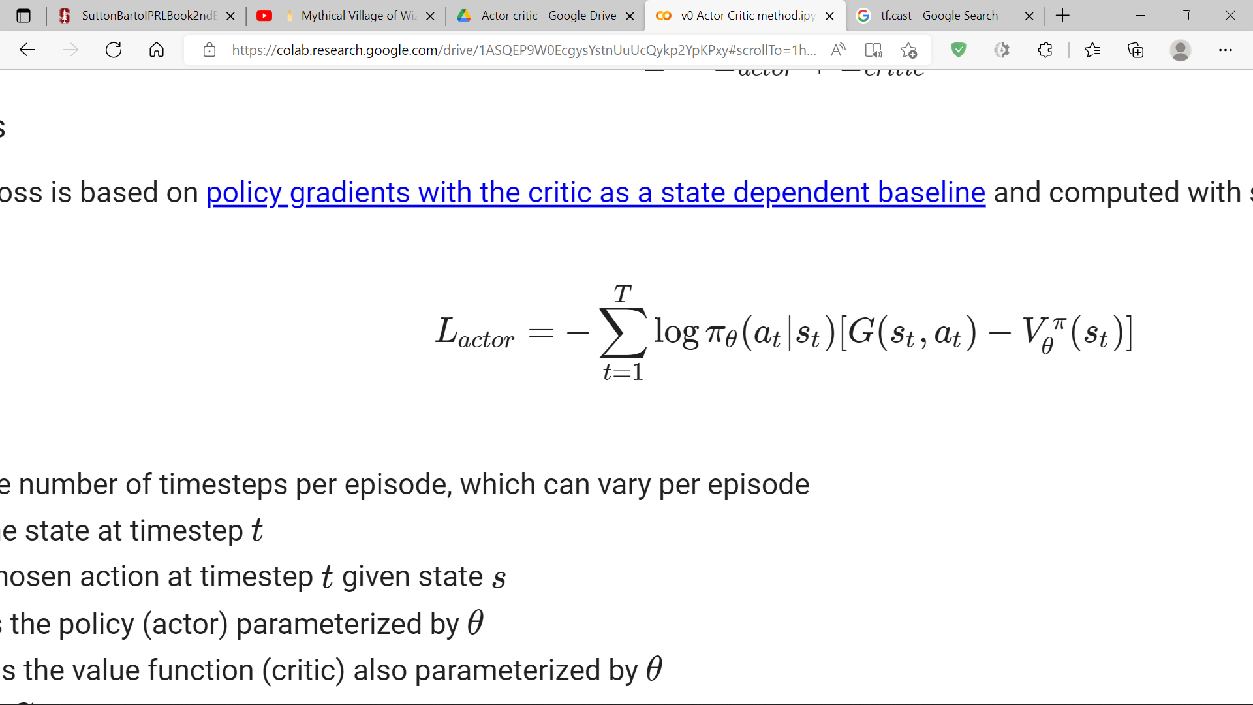
3. The actor-critic loss
Since a actor-critic model is used, the chosen loss function is a combination of actor and critic losses for training, as shown below:
L=L_{actor}+L_{critic}
Actor loss
The actor loss is computed with single-sample (per-episode) estimates.
where:
T : the number of timesteps per episode, which can vary per episode
S_{t} : the state at timestep t
a_{t} : chosen action at timestep t given state s
π_{θ} : is the policy (actor) parameterized by θ
V_{θ}^{π} : is the value function (critic) also parameterized by θ
G=G_{t} : the expected return for a given state, action pair at timestep t
A negative term is added to the sum since the idea is to maximize the probabilities of actions yielding higher rewards by minimizing the combined loss.

Slide 29
Advantage
The G−V term in our L_{actor} formulation is called the advantage, which indicates how much better an action is given a particular state over a random action selected according to the policy π for that state.
Critic loss
Training V to be as close possible to G can be set up as a regression problem with the following loss function:
L_{critic}=L_{δ}(G,V_{θ}^{π})
where L_{δ} is the Huber loss.

Slide 30
4. Defining the training step to update parameters
All of the steps above are combined into a training step that is run every episode.
All steps leading up to the loss function are executed with the tf.GradientTape context to enable automatic differentiation.
Adam optimizer was used to apply the gradients to the model parameters.
The sum of the undiscounted rewards, episode_reward, is also computed in this step. This value will be used later on to evaluate if the success criterion is met.
The tf.function context is applied to the train_step function so that it can be compiled into a callable TensorFlow graph, which can lead to 10x speedup in training.

Slide 31
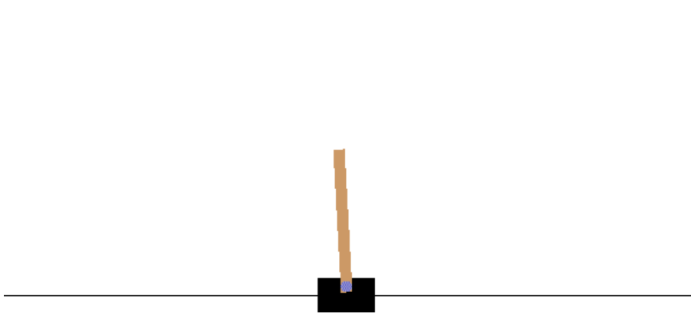
5. Run the training loop
Training is executed by running the training step until either the success criterion or maximum number of episodes is reached.
A running record of episode rewards is kept in a queue. Once 100 trials are reached, the oldest reward is removed at the left (tail) end of the queue and the newest one is added at the head.

Slide 32
Genetic Algorithm based Agent
To solve cartpole problem first create some random training data and then feed it to GA model which in turn will predict the movement of cart(left or right) for every frame.
Collect the data by running the environment many times for random moves i.e. for every frame it will be randomly decided whether our cart goes left or right. If score is greater than or equal to 150 then we are going to store every move we made thereafter.
Store the current action with previous observation. The reason behind it is that at first as the cart was still, there was no observation but when there was an action the observation was returned from the action.
We are considering ‘0’ for ‘left’ and ‘1’ for ‘right’.

Slide 33
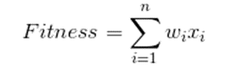
Fiitness function
Initial population will be 8 randomly created set of genes/weights.
The fitness function that we will be using is :
where, w = weights and x = training data.
Observations: cart position ,cart velocity, pole angle.
Actions: left or right.

Slide 34
Selection, Crossover & Mutation
Select the fittest individuals as parents i.e. solutions with the highest fitness value.
Crossover of the 2 parents using single point crossover.
Mutate few offsprings to create diversity in solutions and for that we will add some noise to randomly selected gene of individuals selected for mutation. Randomly interchange bit positions of 2 genes.

Slide 35
Comparison of Actor-critc and GA method
Environment | Training Episodes to achieve target of 300 using Actor critic method | Training episodes to achieve target 150 using GA
ModCartpole V0 | 746 | 1000000
ModCartpole V1 | 9483 | 10000000
ModCartpole V2 | 1195 | 1000000
ModCartpole V3 | 668 | 1000000
ModCartpole V4 | 925 | 1000000

Slide 36
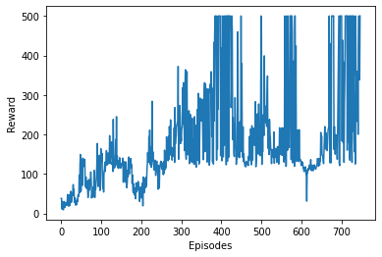
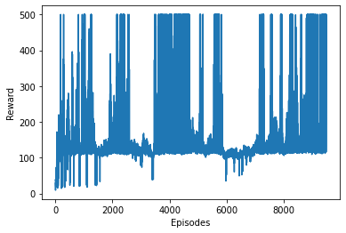
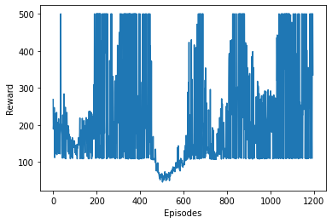
Plot Visualization of Actor critic training
ModCartpole V0
ModCartpole V1
ModCartpole V1

Slide 37
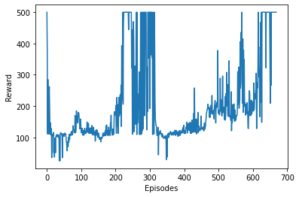
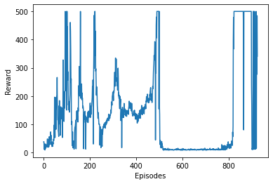
ModCartpole V3
ModCartpole V4

Slide 38
Observations
GA based agent is very much dependent on random moves made without any learning , just to collect the data required for finding optimum weights.
This offline learning process is the core weakness of GA based agent, due to which it fails to achieve high rewards.
Actor critic agent on the other hand uses an online learning process, in which agent initially makes random moves and learns from experience and modifies its actions.
This concept is called a policy which the actor critic agent is learning to optimize by training in the environment.

Slide 39
Conclusion and Future Scope
Actor critic based agent was trained and tested and was found to to score more rewards compared to the GA based agent.
Training process for Actor critic method is very fast compared to the GA based method.
GA based training is slow due to offline learning where as actor critic is an online learning process.
In future we can train the agent using much more advanced versions of actor critic like asynchronous actor critic method.
Actor critic methods performance can be compared with other reinforcement learning methods like DQN, SARSA, REINFORCE etc.
In future work actuator noise can also be added in the environment in addition to the sensor noise while training the agent.
Actor critic method can be used to train a multi tasking agent.

Slide 40
References
Botvinick Mathew, Ritter Sam, Wang Jane, Kurth-Nelson Zeb, Blundell Charles, Hassabis Demis, “Reinforcement Learning, Fast and Slow”, Trends in Cognitive Sciences, Elsevier,Vol 23, pp.408-422, 2019.
Pingchuan Ma, Yunsheng Tian, Zherong Pan, Bo Ren, Dinesh Manocha, “Fluid directed rigid body control using deep reinforcement learning”, ACM Transactions on Graphics,ACM, Vol 37,Issue 4, pp.1-11, August 2018.
H. V. Nghi et , Huynh Vinh Nghi, Dinh Phuoc Nhien, Dang Xuan Ba, "A LQR-based Neural-network Controller for Fast Stabilizing Rotary Inverted Pendulum," International Conference on System Science and Engineering (ICSSE), pp.19-22, 2021.
Johnson, T., Zhou, S., Cheah, W. et al., “Implementation of a Perceptual Controller for an Inverted Pendulum Robot”, Journal of Intelligent & Robotic Systems ,Vol.99, pp.683–692, 2020.
M. Chen, H. K. Lam, Q. Shi and B. Xiao, "Reinforcement Learning-Based Control of Nonlinear Systems Using Lyapunov Stability Concept and Fuzzy Reward Scheme”, IEEE Transactions on Circuits and Systems II: Express Briefs, Vol. 67, no. 10, pp. 2059-2063, Oct. 2020.
Amit Kukker, Rajneesh Sharma, “Genetic Algorithm-Optimized Fuzzy Lyapunov Reinforcement Learning for Nonlinear Systems”, Arabian Journal for Science and Engineering, Springer, Issue.3, 2020.
Brockman G., Cheung V., Pettersson L., Schneider J., Schulman J., Tang J., & Zaremba, W, “Openai gym”, ArXiv Preprint, ArXiv:1606.01540, 2016.
Mohamad H Danesh, Alan Fern, “Out-of-Distribution Dynamics Detection: RL-Relevant Benchmarks and Results”, ICML Workshop on Uncertainty & Robustness in Deep Learning, 2021.
Richard S. Sutton, Andrew G. Barto, “Chapter 11: Policy Approximation”, Reinforcement Learning: An Introduction, Second edition, 2014.

